Slide 1
Geodetic Acoustic Ray Solutions in the Time Domain
Mr. Sean M. Reilly
PhD Student – URI Ocean Engineering Dept
March 11, 2010

Slide 2
Developing a new acoustic propagation loss model
Combine best-of-breed techniques from multiple sources of prior art.
Littoral environments (bottom interactions important, but deep enough for ASW)
Good performance at active sonar frequencies
Time/angle info needed by training systems
Broadband applications (impulse response)
Much faster than current Navy standards
Minimal losses in accuracy

Slide 3
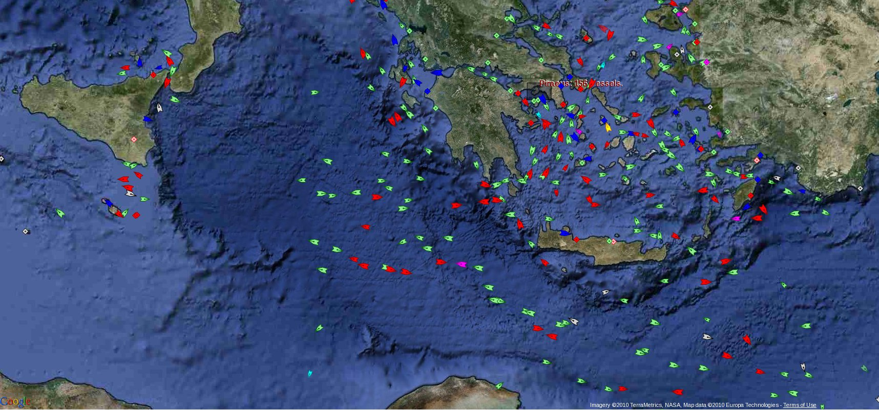
Motivation ⇨ TASW Training Systems
AIS merchant ship traffic report from MarineTraffic.com on 02-16-10
Italy
Greece
Turkey
zoom-in
Typical Theater ASW exercise requires littoral ocean TL calculations at rate of 1500 target/sensor pairs per minute, in real-time, across operating area (not including reverb TL)‏

Slide 4
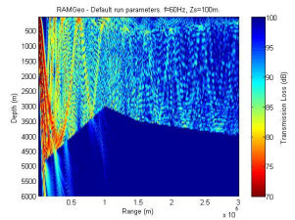
Navy Standards are 2-DxN
AIS merchant ship traffic report from MarineTraffic.com on 02-16-10
Extract Radial and
Compute TL
TL image from http://cmst.curtin.edu.au/products/actoolbox/
TL calculations done in a simple (x,y) system. But, radial extraction has its own accuracy losses and CPU costs.
Extracting 3-D Cartesian systems is even more costly.

Slide 5
Re-Visiting Ray Theory
Why Ray Theory?
  Better support for active sonar frequencies.
  Better support for time/angle info needed by training systems.
Leverage successes in Gaussian Beams
  Model lower frequency using leakage effects.
  Example: GRAB model by Weinburg, Keenan, 1996.
  Example: FeyRay model by Foreman, 2007.
Leverage successes in 3-D spherical coordinate systems
  Navy ocean products natively support lat/long/alt.
  Lat/long/alt as TL coordinate system avoids extraction costs.
  Rays automatically follow great circle routes.
  Supports 3-D out of plane effects (more on this later).
  Example: HARPO model by Jones, Riley, Georges, 1986.
Time Domain
  Maintain phase continuity of wavefront to improve interp performance
  Natural domain for computing broadband impulse response

Slide 6
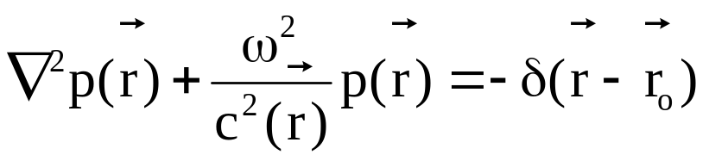
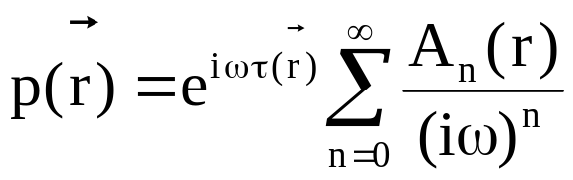
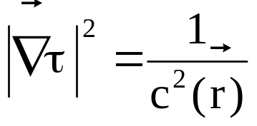
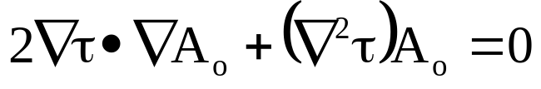
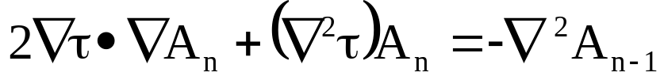
Wave Equation ⇨ Ray Theory
Look for solutions in the form:
Match powers of ω:
O(ω²) :
O(ω) :
O(ω^{1-n}) :
(eikonal)
(transport)
(diffraction)

Slide 7
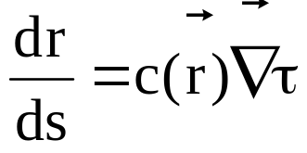
Ray Trajectories
eikonal ⇨ characteristic paths of the rays
transport ⇨ amplitude proportional to ray divergence
diffraction ⇨ small if “c” changes slowly over wavelength

Slide 8
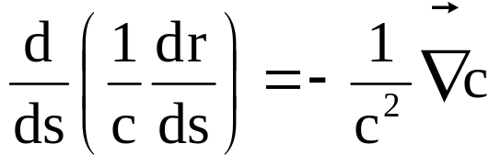
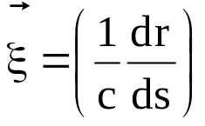
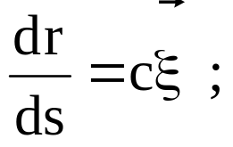
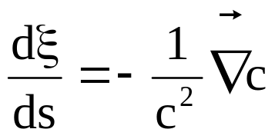
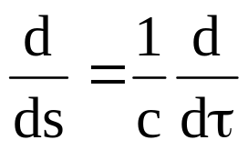
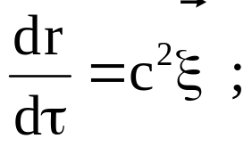
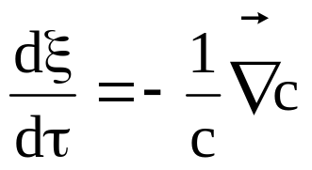
Ray Paths in Time Domain
1) eikonal
2) rays along paths
3)
4)
Coupled ODEs = Initial Conditions + Marching Solution

Slide 9
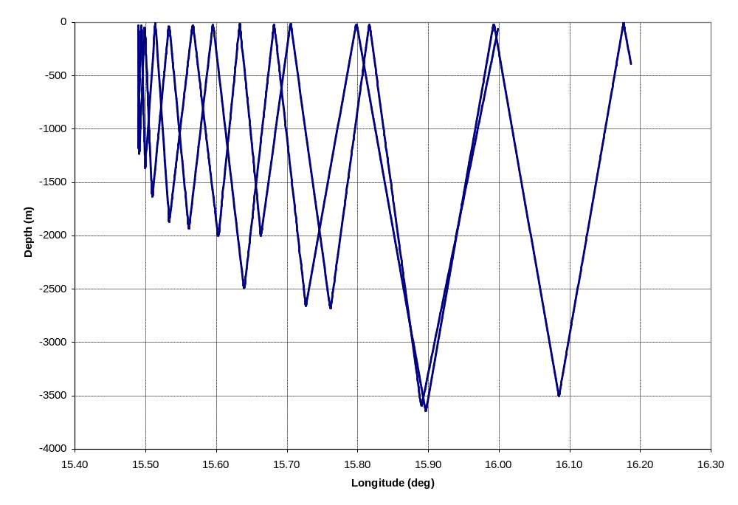
3-D Upslope Propagation
270 deg azimuth
source at 36N 16E
?
marches up the slope
then back out to sea

Slide 10
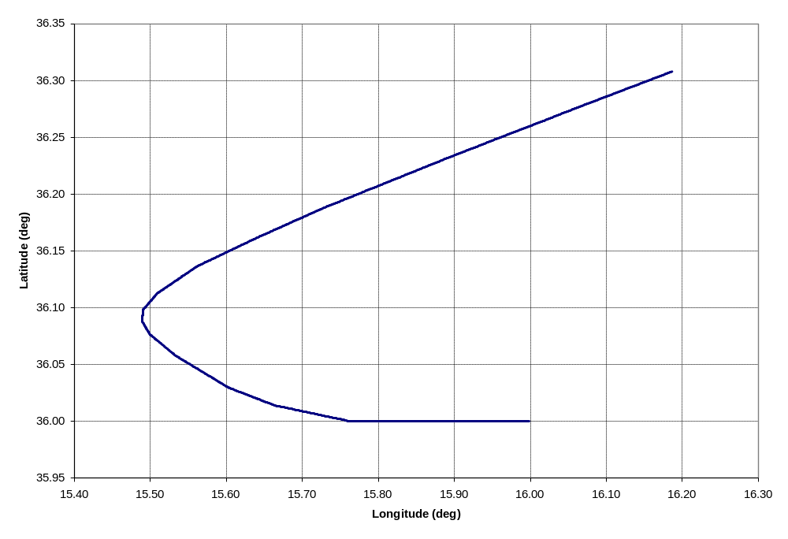
Out of Plane Effects
15 nmi
≈ URI to CT
source at 36N 16E

Slide 11

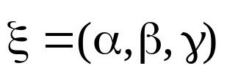
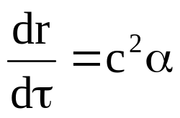
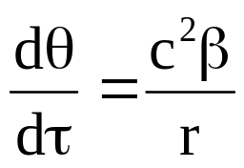
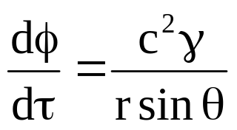
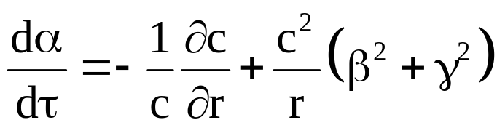
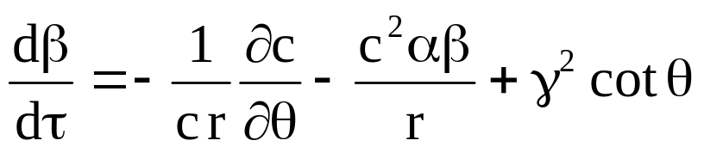
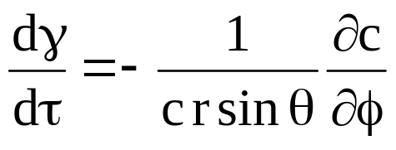
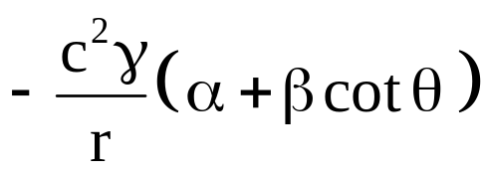
3-D Geodetic Coordinates
Use WGS-84 ellipsoid to approximate a local spherical polar coordinate system
Earth’s axis
area of operations
h
R
center of
equator
the earth
latitude
center of
curvature
longitude

Slide 12
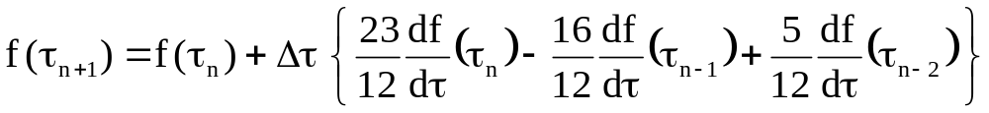
Adams-Bashforth Integrator
AB3 estimates next step from the previous 3 steps.
  Propagator is circular queue of 4 wavefronts.
Single interpolation of sound speed and derivative per iteration.
Single calculation of sin θ, and cot θ per iteration.
Integrator choice actually makes it faster than many other 3-D Cartesian methods (such as RRA).
But not self starting. Requires slower Runge-Kutta (RK3) during initialization and reflection.

Slide 13
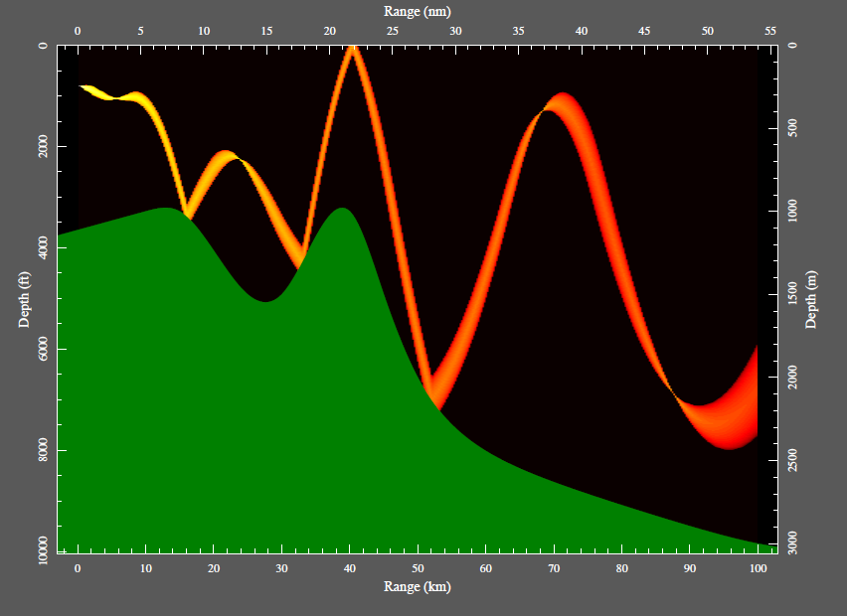
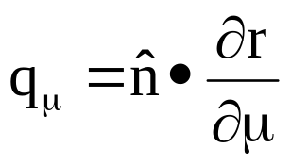
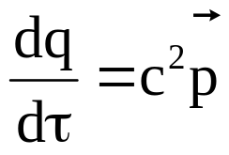
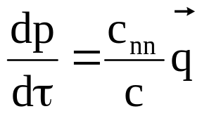
Gaussian Beams
Reference: T. L. Foreman, “FEYRAY Gaussian Beam Underwater Acoustic Propagation Model”
Give each ray a Gaussian profile, overlap neighbors.
Dynamic ray equations compute changes in profile width.
Sum each beam contribution as it passes target.

Slide 14
Hybrid Gaussian Beams
Use ray spreading to estimate divergence
instead of using dynamic ray equations.
Model shadow zone
effects as if they were evanescent leakage from neighboring cells.
Continuity of time domain wavefront keeps all contributions in phase.
Note that shading
in beam angle space is equivalent to convolution
in wavenumber space.
Launch D/E
μ
j+2
Gaussian
beam centers
μ
j+1
μ
j
Eigenray
Target
Peak α
1/width
μ
j
-
1
ϕ
ϕ
ϕ
ϕ
k
-
1
k
k+1
k+2
Launch AZ
Reference: H. Weinberg, R. E. Keenan, “Gaussian ray bundles for modeling high-frequency propagation loss under shallow-water conditions.”

Slide 15
Think about Software Engineering!
“The application of a systematic, disciplined, quantifiable approach to the development, operation, and maintenance of software.”
  Wikipedia, The Free Encyclopedia, 2/16/2010
The success of this model will ultimately be judged by those who integrate it into their own systems.
  They just need a library with no GUIs, no scripting languages, and no new input file formats.
  Choose to make a “good saw” not a “sturdy building.”

Slide 16
Template Meta Programming
C++ templates can execute operations at compile time.
This project uses Boost’s uBLAS vector/matrix library to provide C++ syntax at hand-coded assembly speeds.
Extends uBLAS into Matlab-like suite of C++ operations.
template<int N>
class Factorial {
public:
enum { value = N * Factorial<N-1>::value };
};
class Factorial<1> {
public:
enum { value = 1 };
};
Reference: T. Veldhuizen, "Using C++ template metaprograms," C++ Report, Vol. 7 No. 4 (May 1995).

Slide 17
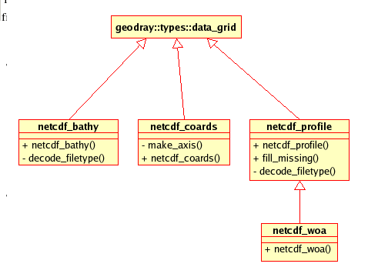
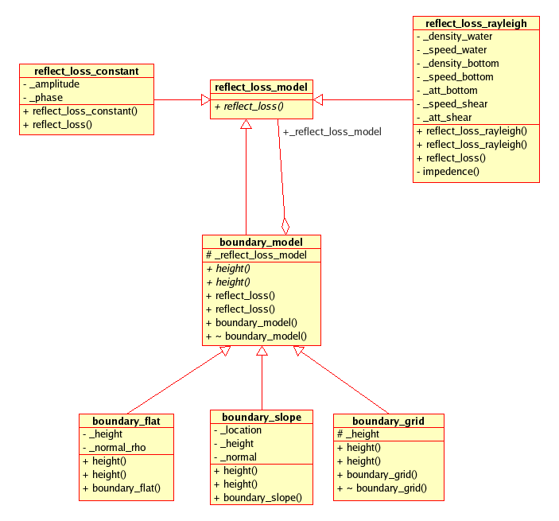
Data Source Abstraction
model provides
abstract interfaces
aggregation
improves
decoupling
specific implementations

Slide 18
Standard Databases
Need realistic test cases during development.
  Higher resolution expected for production systems.
Publicly available data sources
  Such as National Oceanographic Data Center
    http://www.nodc.noaa.gov
  ETOPO2 – 2 nmi Bathymetry
    Smith/Sandwell world-wide
  World Ocean ATLAS – 60 nmi SVP Monthly Average
    Temperature, salinity, dissolved oxygen, oxygen saturation, etc.
    Mackenzie model for the speed of sound vs. temperature and salinity.
  etc.
Limited distribution ocean databases
  Such as Oceanographic and Atmospheric Master Library (OAML)
  Implementated in a separate package with common interface.

Slide 19
Verification ⇨ Works as Designed
Use Boost Test Library to manage a library of tests for each C++ class.
Do the model components each accomplish the job that they were designed to do?
Compare to analytic results before errors creep into final product.

Slide 20
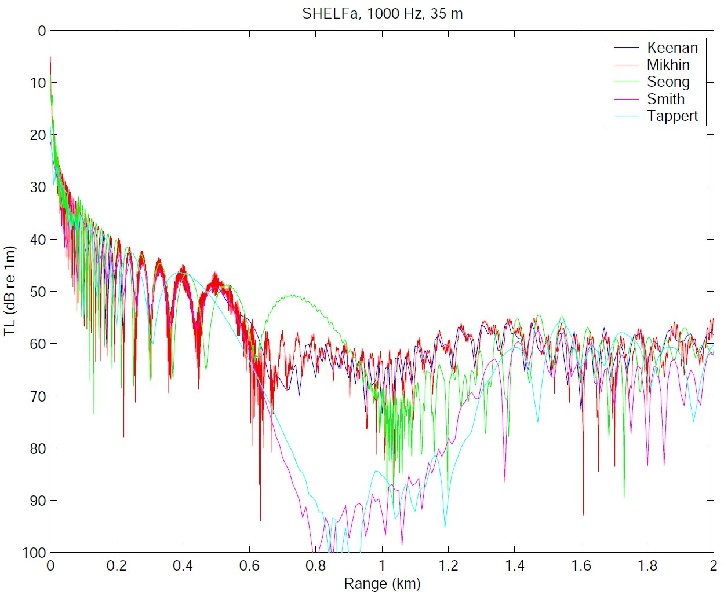
Validation ⇨ Estimate Accuracy
GRAB
PE
SWAM99 Test Cases
Experts: Please evaluate this!

Slide 21
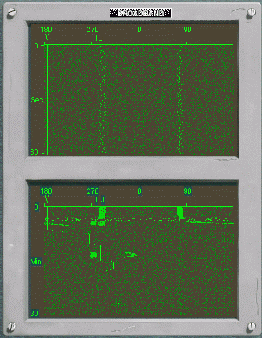
What matters to the sailor?
http://easyweb.easynet.co.uk/ianboys/688rev.htm
Detection ranges similar to those expected in “real life”.
  PACFLT: “At 30 nmi, we need 1-2 nmi accuracy”.
Fluxuations similar to those expected in “real life”.
688I Video Game

Slide 22
Relate to Signal Excess
Passive Sonar Example:
  SE = SL – TL – (NL – DI) + PG - DT
  FOM = SL – (NL – DI) + PG - DT
  SE = FOM – TL = 10 log (SNR)
Sonars display SE in dB units
  ex: 8 colors at 2 dB/color ⇨ 40 times louder
Realistic FOMs range from 60-100 dB

Slide 23
CNMOC’s FeyRay Validation
http://easyweb.easynet.co.uk/ianboys/688rev.htm
Assume the RAM PE is the best representation of “real world”.
  Big assumption!
Mean difference in dB.
  Compares average detection range effects.
Pearson correlation coefficient in dB.
  Compares target fading effects.
688I Video Game

Slide 24
Validation Test Plan
Compare to benchmark use cases defined by NPS and ONR for the for Shallow Water Acoustic Modeling Workshop, September 1999.
  Improve on SWAM99 results by defining specific metrics for model-to-model comparisons (based on prior work with FeyRay).
  Validate the selected metrics against an accepted set of "looks good to the experts" results.
Model-to-model comparisons to 800+ sample environments
  defined by OAML CIMREP for the FeyRay-to-RAM PE comparison.
Compare model predictions to littoral sea test data from other URI efforts.

Slide 25
Progress Report
Acoustic ray tracing in latitude, longitude, altitude, and time
  3-D tests successful, so far.
  Ray tracing parts at 20 times faster than equiv. parts of FeyRay, which is 20 times faster than GRAB.
Gaussian beam part needs a lot of work.
  Is our hybrid Gaussian beams concept even valid?
  Will the wavefront be smooth enough after 10-20 reflections?
  Can it be computed fast enough?
  How does accuracy measure up against other standard models?

Slide 26
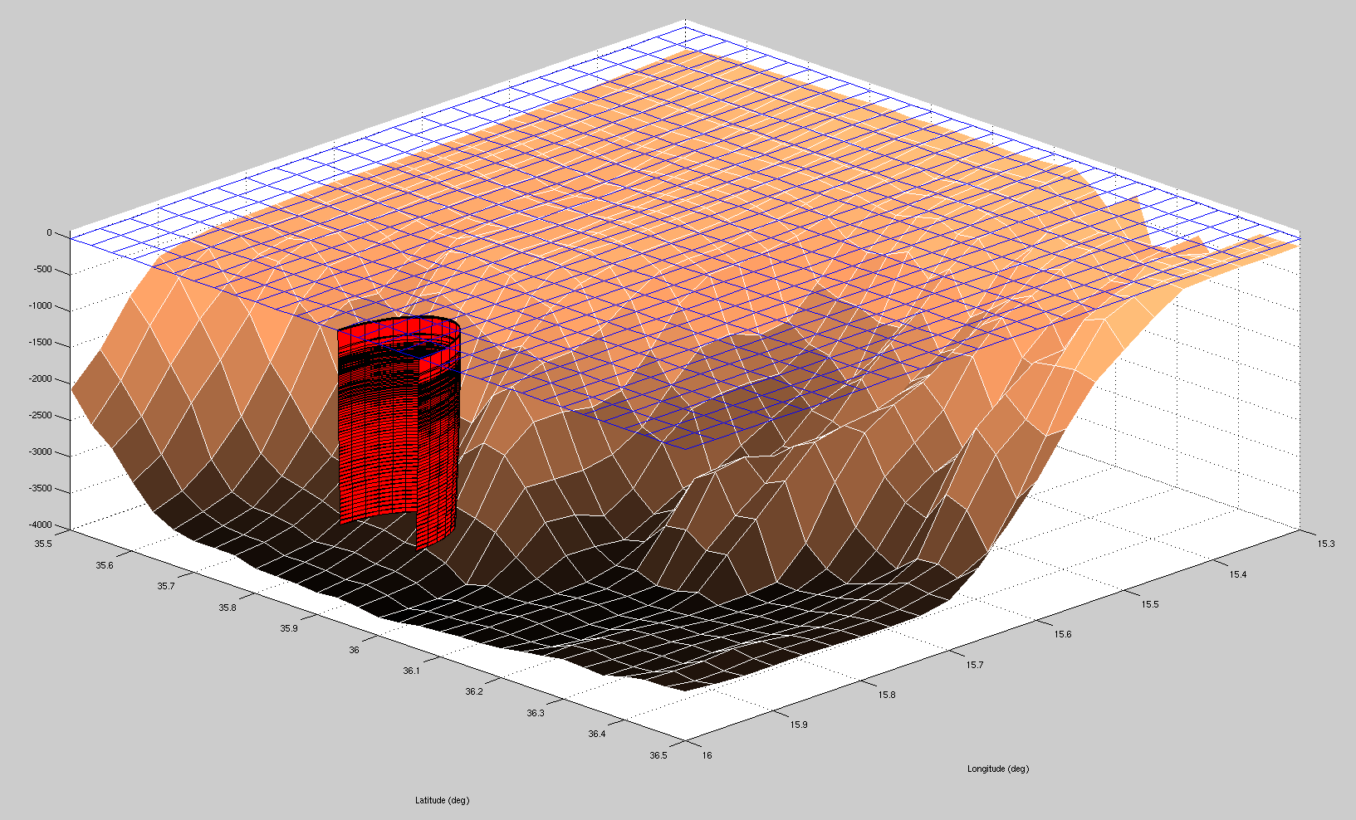
Matlab Demonstration
Malta Escarpment
Latitude (deg)‏
Longtitude (deg)‏

Slide 27
Further Reading
R.M. Jones, J.P. Riley, T.M. Georges, “HARPO: A Versatile Three-Dimensional Hamiltonian Ray-Tracing Program for Acoustics Waves in an Ocean with Irregular Bottom,” NOAA, 1986.
V. Cerveny, M. M. Popov, and I. Psencik, “Computation of wave fields in inhomogeneous media – Gaussian beam approach,” Geophys. J. R. Astron. Soc., 70, pp. 109-128, 1982.
M. B. Porter, H. P. Bucker, “Gaussian beam tracing for computing ocean acoustic fields,” J. Acoust. Soc. Am. 82 (4), October 1987.
Ziomek, Lawrence, "The RRA Algorithm: Recursive Ray Acoustics for Three-Dimensional Speeds of Sound," IEEE Journal of Oceanic Engineering, vol. 18 no. 1, January 1993.
H. Weinberg, R. E. Keenan, “Gaussian ray bundles for modeling high-frequency propagation loss under shallow-water conditions.” J. Acoust. Soc. Am. 100 (3), 1421-1431, Sept 1996.
F. B. Jensen, W. A. Kuperman, M. B. Porter, and H. Schmidt, Computational Ocean Acoustics, American Institute of Physics Press, New York.
P. A. Baxley, H. Bucker, M. B. Porter, “Comparison of Beam Tracing Algorithms,” Proceedings of the Fifth European Conference on Underwater Acoustics, ECUA 2000.
The FEYRAY Gaussian Beam Underwater Acoustic Propagation Model, Terry L. Foreman, Navy Warfare Development Center, 5 Jan 2007.

